Slide 1
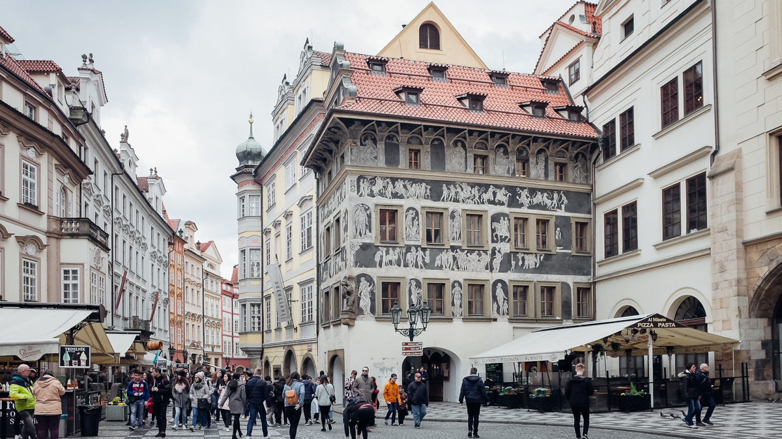

Slide 2
“Youth is happy because it has the capacity to see beauty. Anyone who keeps the ability to see beauty never grows old.” - Franz Kafka

Slide 3


Slide 4
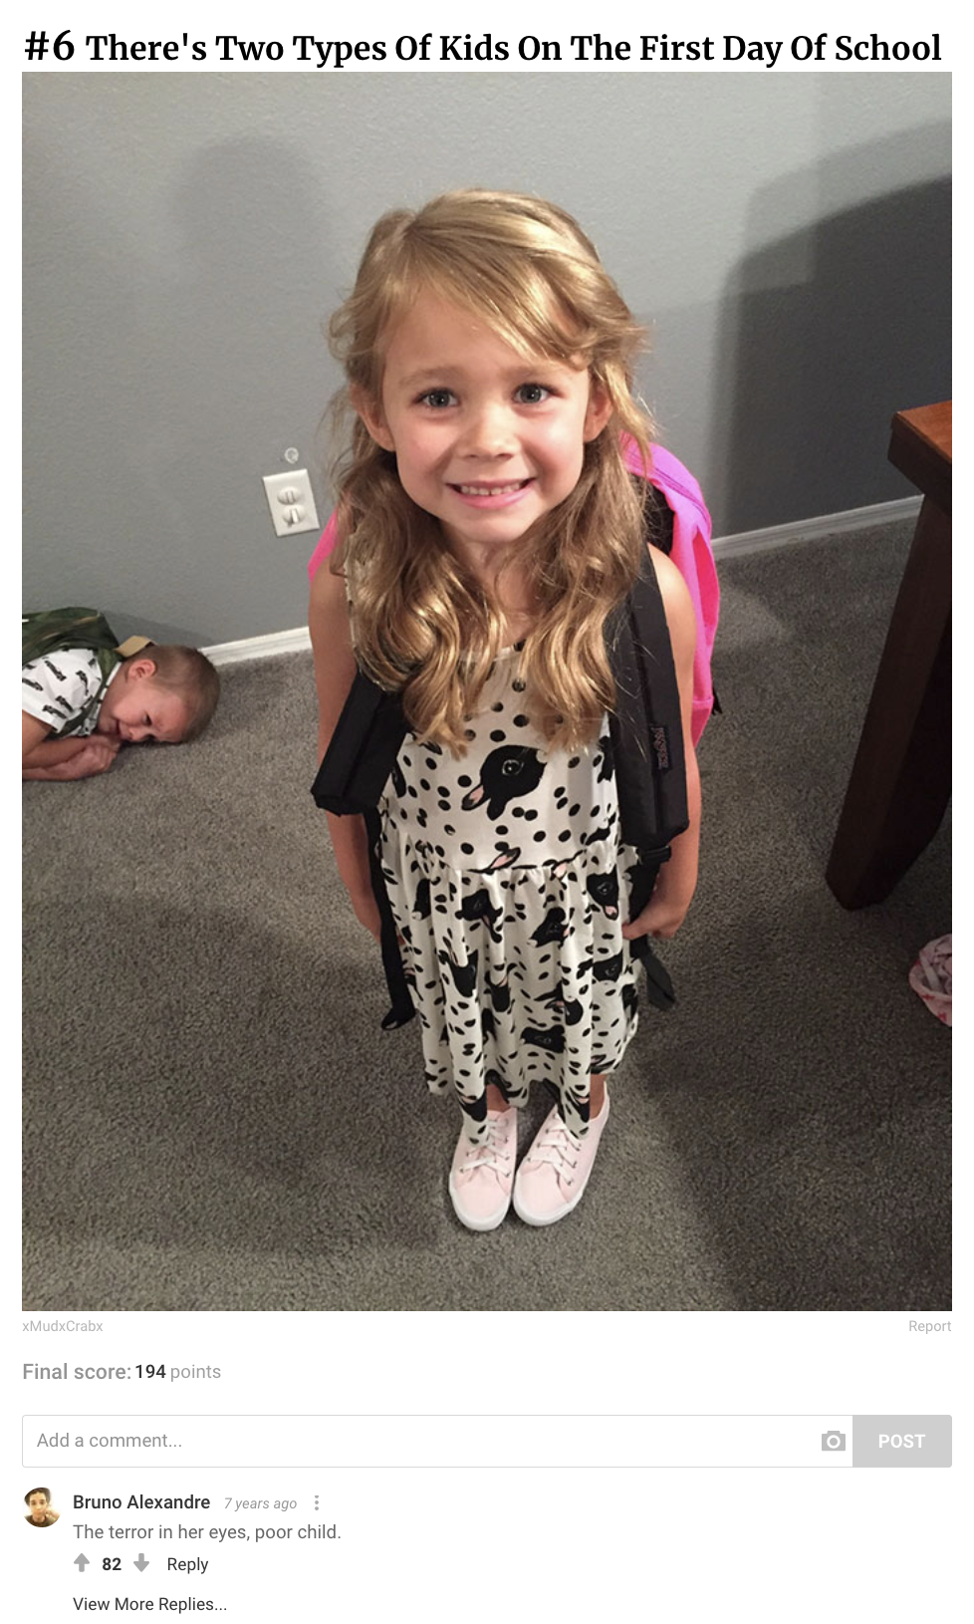
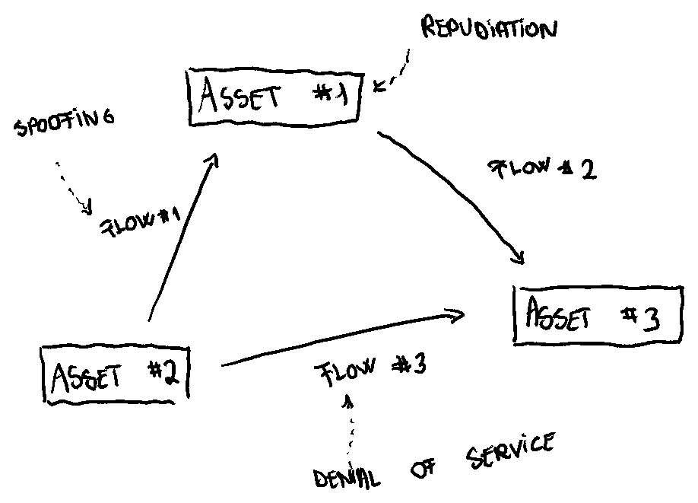
Kid
Vulnerability researcher
Pleasure maximization
Threat modelling

Slide 5

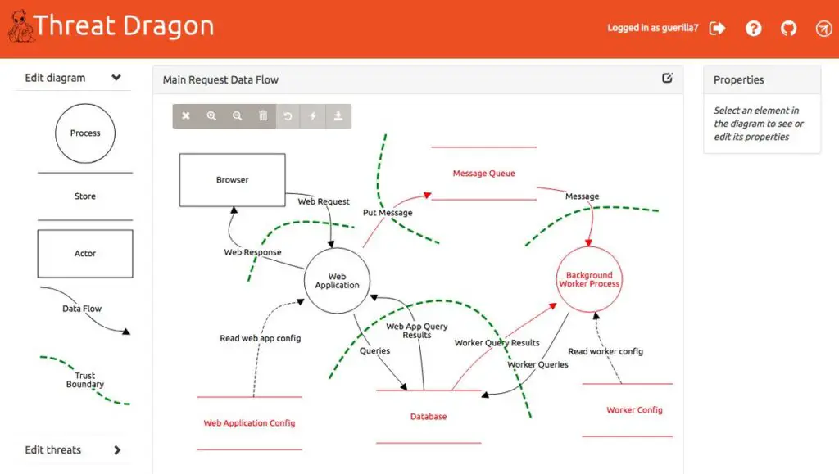
Kid
Vulnerability researcher
Pleasure maximization
Threat modelling with Threat Dragon

Slide 6
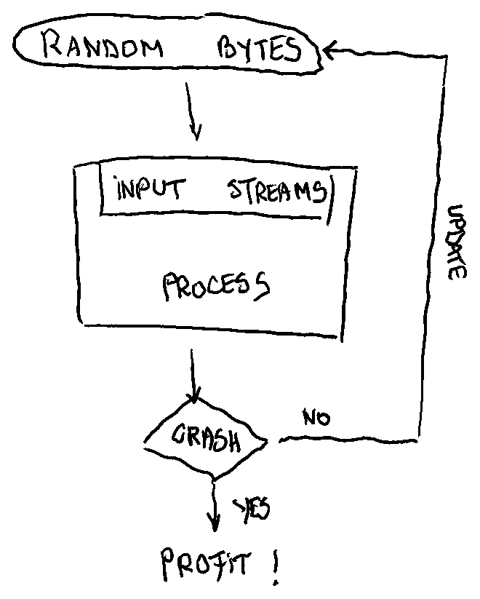
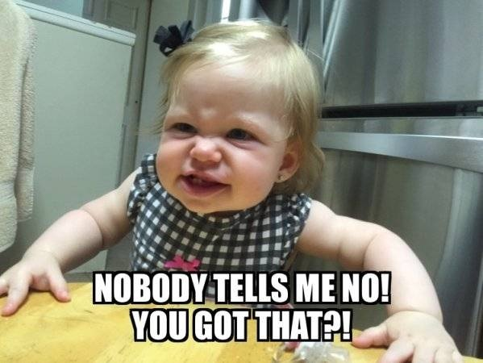
Kid
Vulnerability researcher
Curiosity
Fuzzing

Slide 7

Kid
Vulnerability researcher
$ AFL_USE_ASAN=1 /AFLplusplus/afl-cc -g -o program.elf program.c
$ afl-fuzz -i inputs/ -o outputs/ -- program.elf @@
Curiosity
Fuzzing with AFL++

Slide 8
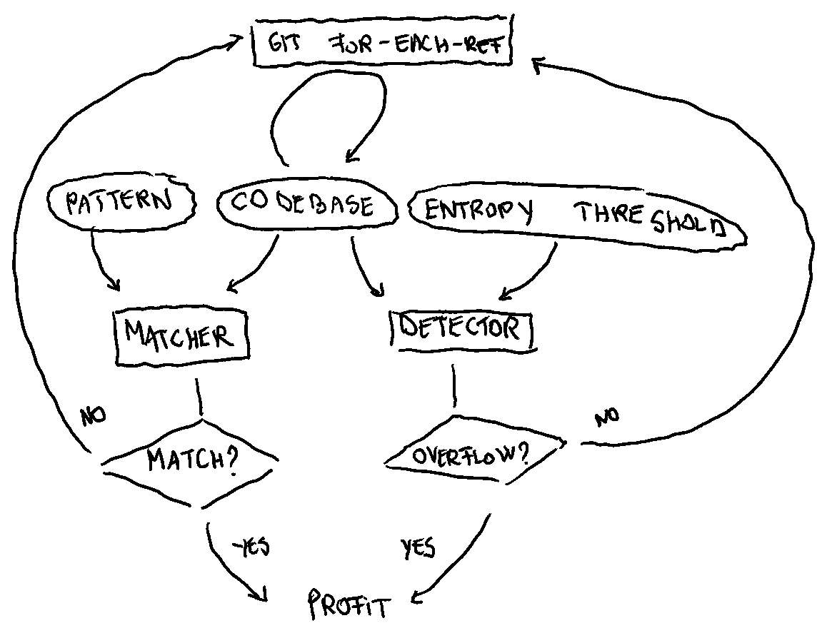
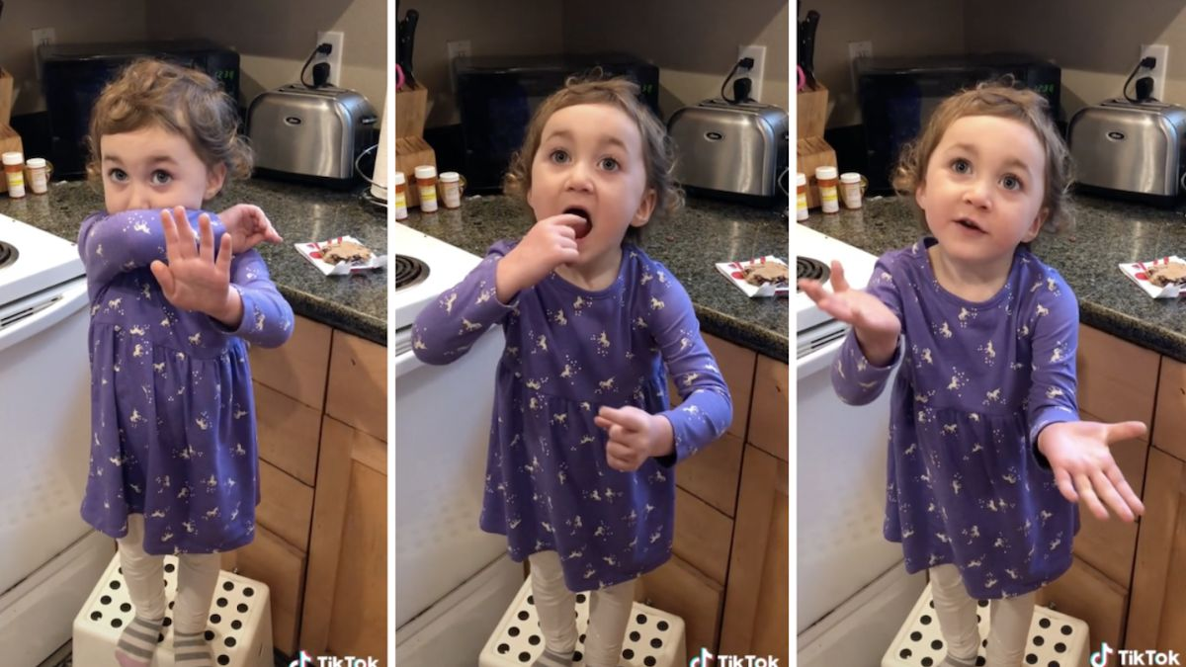
Kid
Vulnerability researcher
Sugar addiction
Secret scanning

Slide 9

Kid
Vulnerability researcher
$ gitleaks detect --report-path report.json
Sugar addiction
Secret scanning with Gitleaks

Slide 10
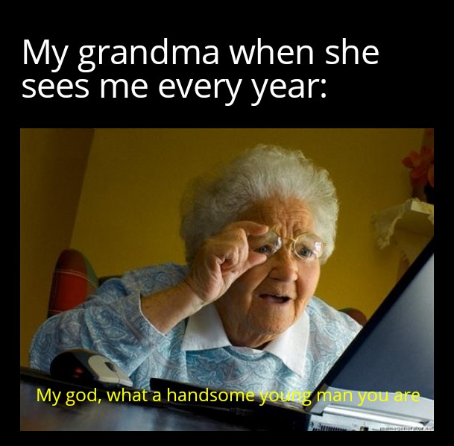
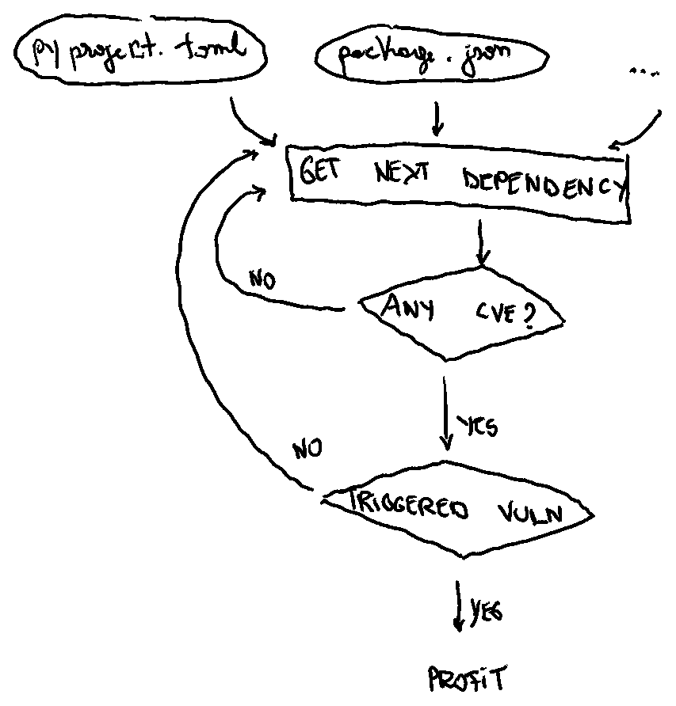
Kid
Vulnerability researcher
Persuasion
Dependency scanning

Slide 11

Kid
Vulnerability researcher
$ osv-scanner --lockfile codebase/portrait/poetry.lock
Persuasion
Dependency scanning with OSV-Scanner

Slide 12

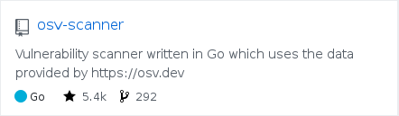
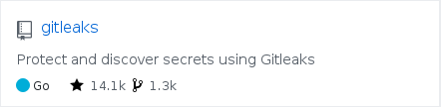
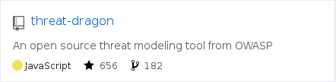

Slide 13

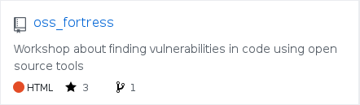


Slide 14


Slide 15
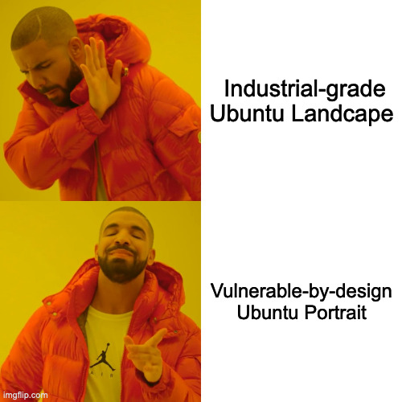

Slide 16
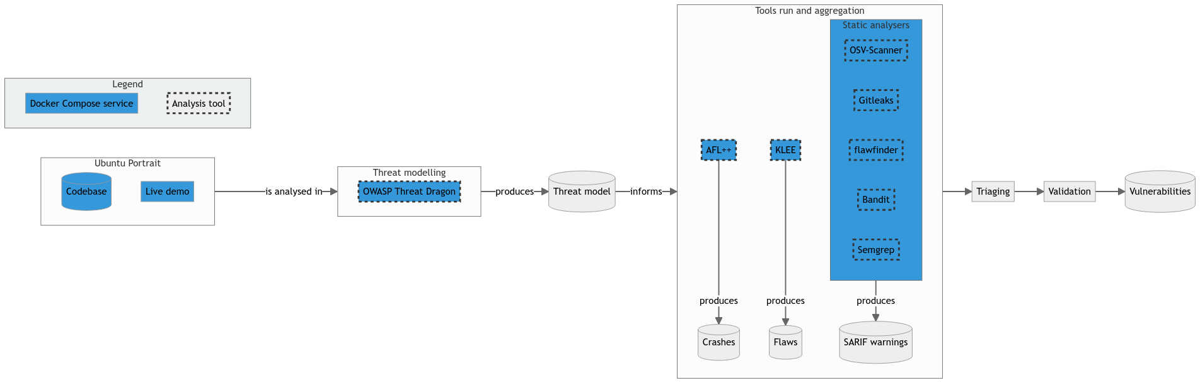

Slide 17
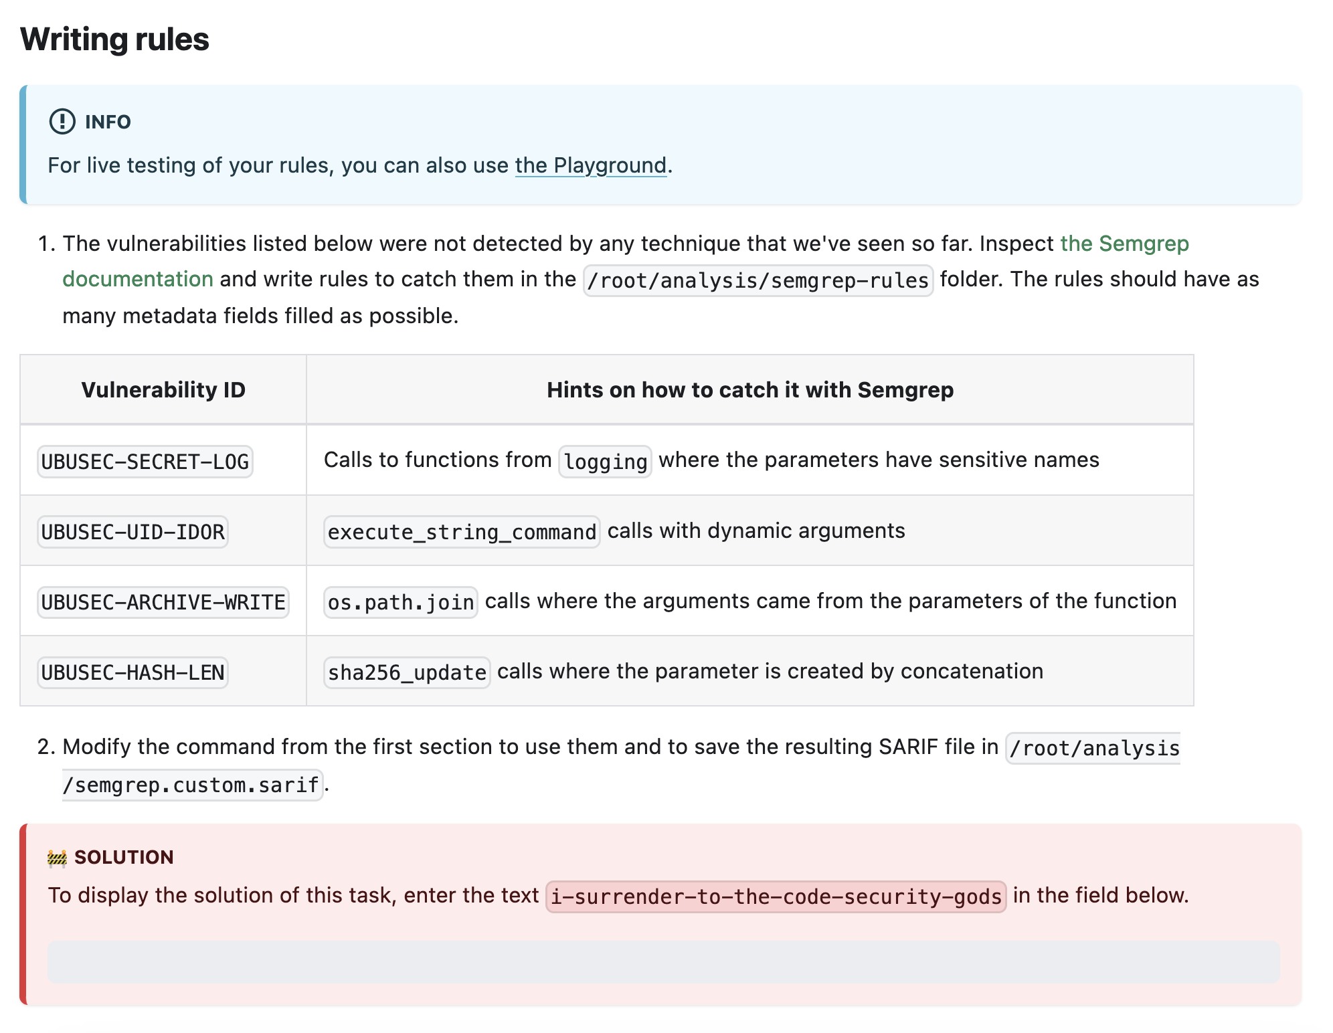

Slide 19
